Slide 1
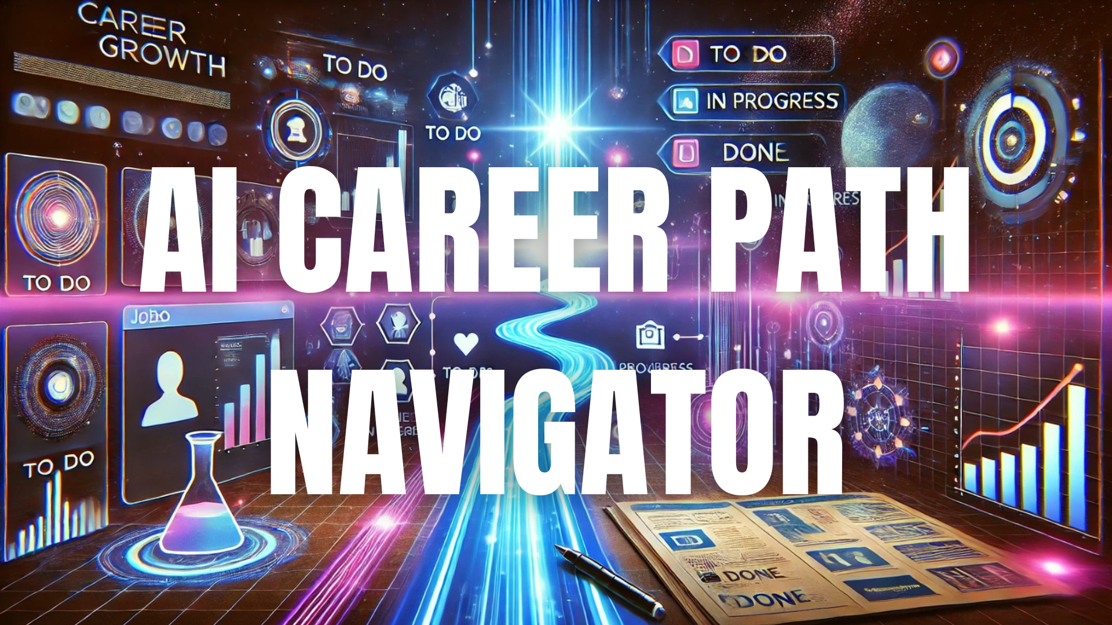

Software Project Management
with Trello

Slide 3




MEET THE CREW
Noor
(Frontend Dev)
Umaima
(Frontend Dev)
Tayyaba
(Backend Dev)
Ghania
(UI UX designer)
Raveeha
(Scrum Master)

Slide 4


WHAT IS
CAREER PATH NAVIGATOR
provides structured pathways, career recommendations, and personalized insights to simplify this process.
Provide AI-driven career guidance to the students.
.
01
04
Target Users : Students , Counselors , Professionals
02
05
tool to help them align their aspirations with real-world opportunities,
Recommends suitable job and internship opportunities.
03
06
Identifies skill gaps and suggests relevant courses to enhance employability.

Slide 5

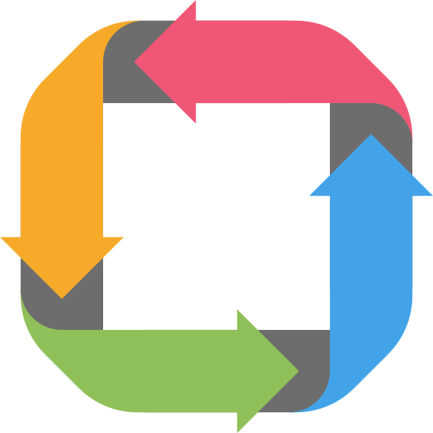

Improved Productivity
Scrum Sprint Approach
SOFTWARE PROJECT MANAGEMENT APPROACH
04
01
The Scrum Sprint Approach enables iterative development, ensuring efficient task management and continuous improvements. By breaking features into sprints, progress tracking becomes easier and more structured. Trello helps manage workflow visually with columns like To Do, In Progress, Testing, and Done, allowing real-time updates and better productivity throughout the project. 🚀
03
02
Trello for Workflow Management
Efficient Task Breakdown

Slide 6


AGILE WORKFLOW IN ACTION
🔹 Final Sprint Refinements – Bug fixes & user testing.
🔹 Sprint Breakdown – Four 2-week sprints structured development.
06
01
05
🔹 Adaptive Planning – Adjusted sprints based on feedback.
🔹 Daily Standups – Quick check-ins for progress updates.
02
04
03
🔹 Task Lifecycle – Tasks moved through Backlog → Done.
🔹 Collaboration Tools – Trello & Power-Ups kept work aligned.

Slide 7

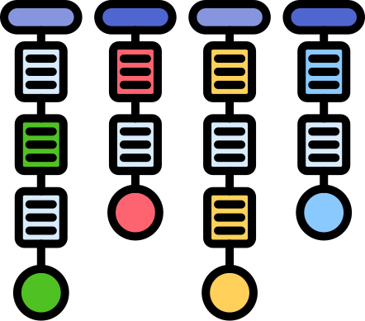

SPRINT PLANNING & EXECUTION
SPRINT BREAKDOWN
Four 2-week sprints for structured development.
SPRINT PHASES
UI/UX Design , Development, Integration , Feedback,Testing, Deployment
TEAM COLLABORATION
Tasks updated in Trello for real-time tracking
Sprint reviews ensured smooth progress & quality
EXECUTION & REVIEW

Slide 8


01
Boosting Productivity with Power-Ups✨
WHAT YOU NEED TO KNOW ABOUT POWER
UPS
📅 Calendar: Tracked deadlines and ensured timely task completion.
02
03
⏳ Time Tracking: Monitored effort spent on each task for better efficiency.
04
📊 Gantt Chart: Provided a clear visual timeline of project progress.
05
📈 Corrello Power-Up – Provided agile dashboard insights with sprint metrics

Slide 9
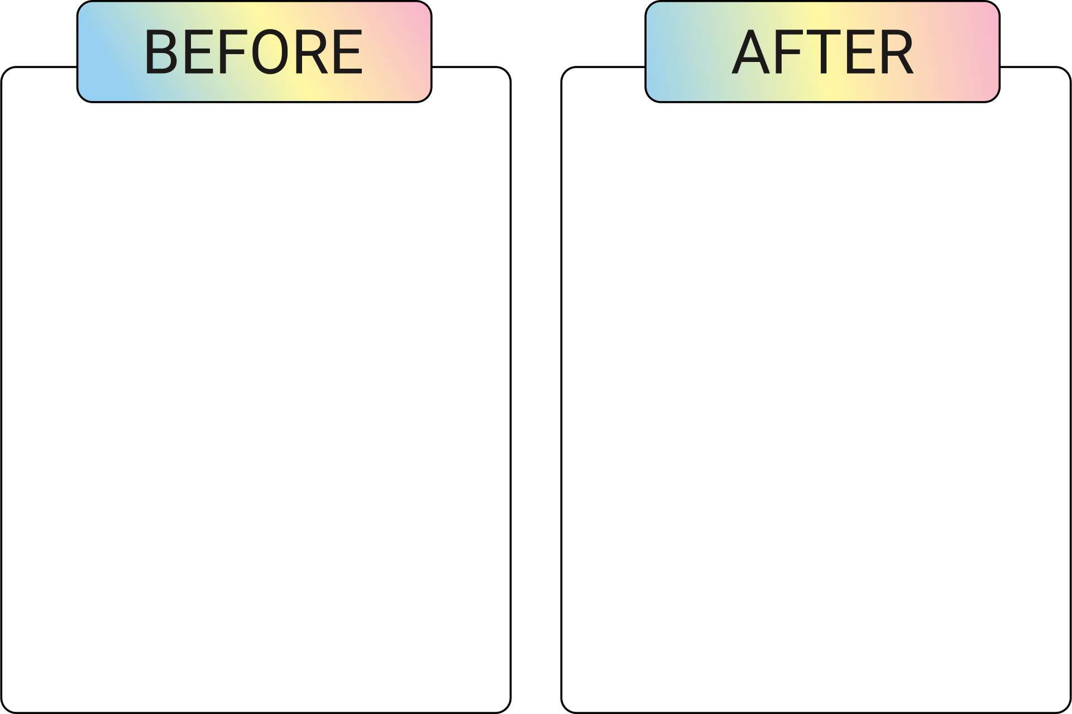

CHALLENGES & SOLUTIONS 🚀
🔹 ⏳ Sprint Deadlines:
Balancing feature completion within 2-week sprints.
🔹 👥 Team Coordination: Managing availability and task ownership.
🔹 📌 Task Overload:
Prioritizing tasks and avoiding backlog pile-ups.
🔹 🔍 Progress Tracking:
Ensuring visibility of sprint progress and pending work.
✅ Clear Priorities:
Tasks organized in To Do, In Progress, Testing, Done columns.
✅ Better Collaboration: Assigning tasks and updating status kept everyone aligned.
✅ Backlog Management: Ensured no feature was overlooked, reducing last-minute rush.
✅ Real-time Tracking:
Corrello Power-Up provided insights with sprint analytics.
05
03

Slide 10

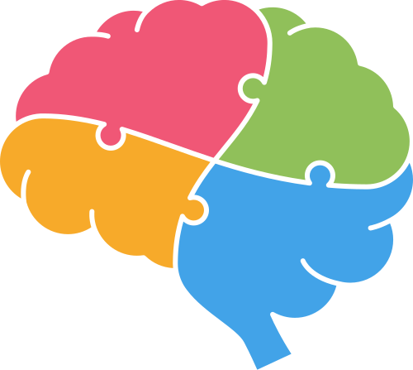



KEY LEARNINGS & IMPROVEMENTS IN 4 STEPS
Enhanced Collaboration
Future Enhancements
04
01
03
02
Improved Accountability
Efficient Tracking

Slide 11
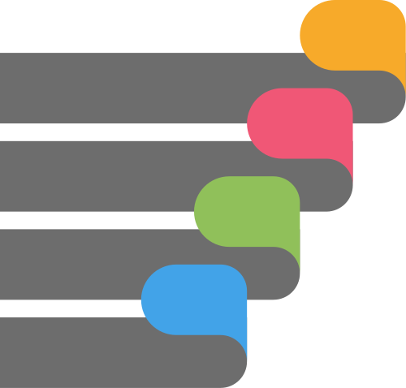




CONCLUSION & DEMO
01
Project Summary
02
Live Trello Demo
This project demonstrated how structured project management transforms an idea into an efficient, scalable solution. 🚀
03
Documents
04
IMPACT & TAKEAWAYS

Slide 12
THANK YOU
0316-4509582
mohsinraveeha@gmail.com
reallygreatsite.com

